Slide 1


Slide 2
What were they doing yesterday?
Joe Javier Martha Robert Mary and Alfred
Joe was taking a shower yesterday
Javier was having the lunch yesterday
Martha was buying in the market yesterday
Robert was washing his clothes yesterday
Mary and Alfred were driving their cars yesterday

Slide 3
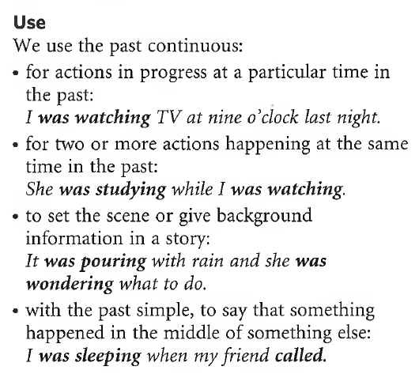

Slide 4



AFFIRMATIVE FORM
I | WAS | playing
We You They | WERE
He She It | WAS

Slide 5
NEGATIVE FORM
I | Wasn’t (Was not) | playing
We You They | Weren’t (Were not)
He She It | Wasn’t (Was not)

Slide 6
INTERROGATIVE FORM
Was | I | playing?
Were | We You They
Was | He She It

Slide 7

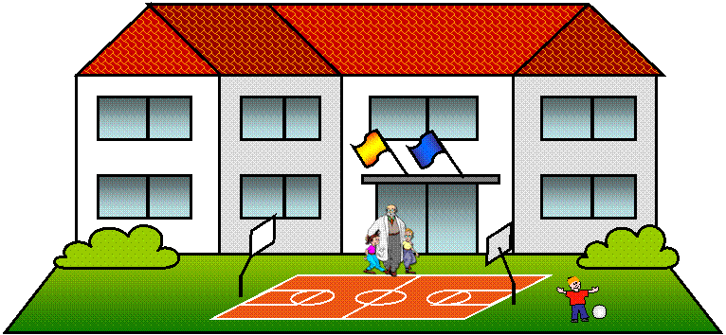
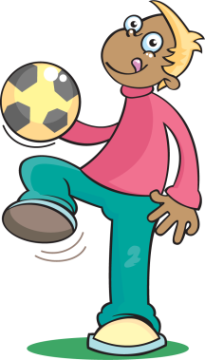
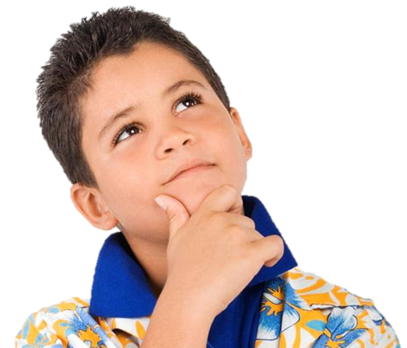
What was he doing yesterday at noon?
He was playing football at school

Slide 8


What was he doing yesterday at 4 p.m.?
He was doing his homework

Slide 9

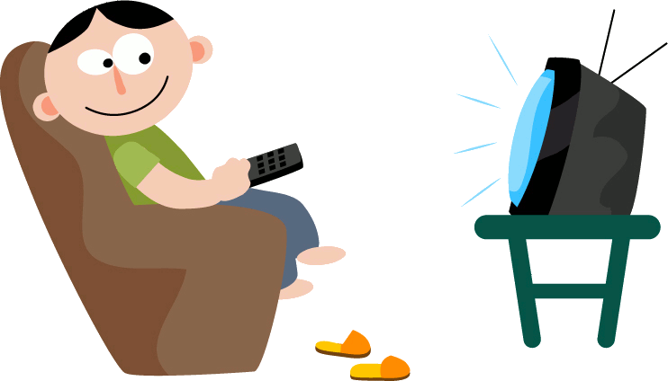
What was he doing yesterday at 9 p.m.?
He was watching TV

Slide 10
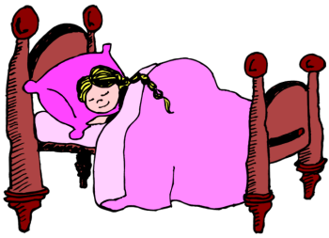

Was she watching TV yesterday at midnight?
No, she wasn’t.
She was sleeping.

Slide 11
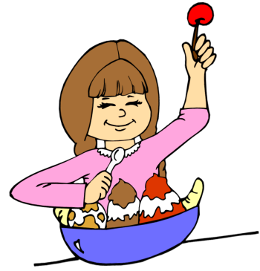
Was she having dinner yesterday at 9 p.m.?
Yes, she was.

Slide 12
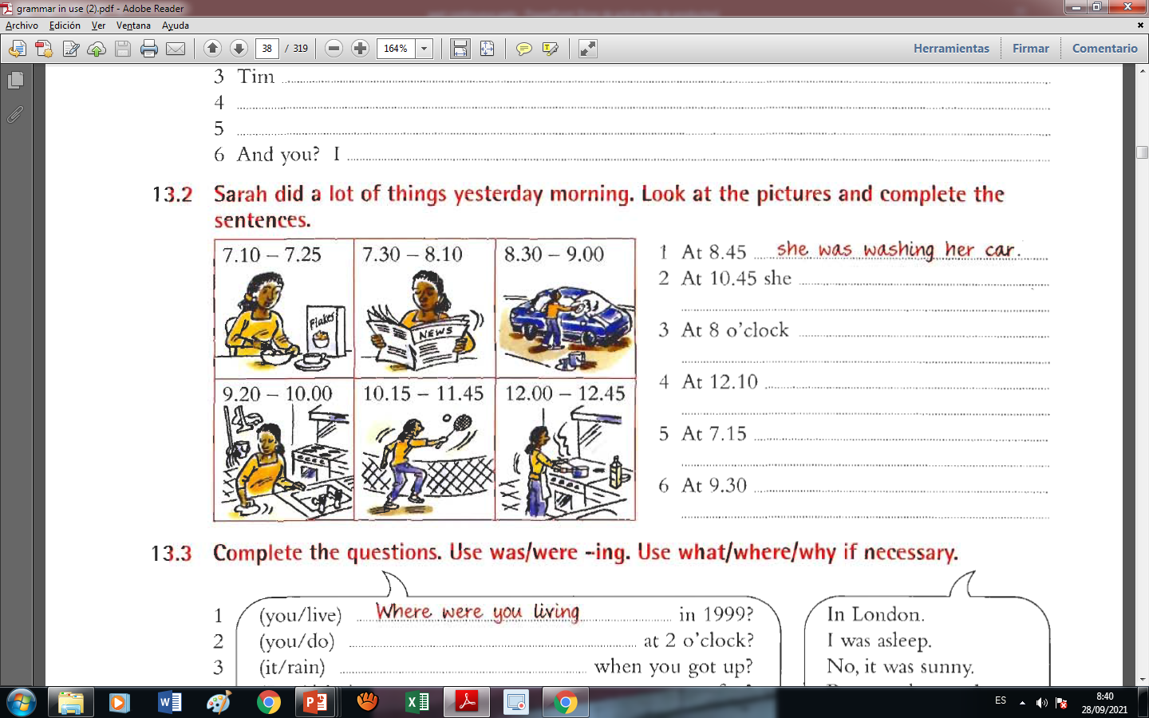

Slide 13
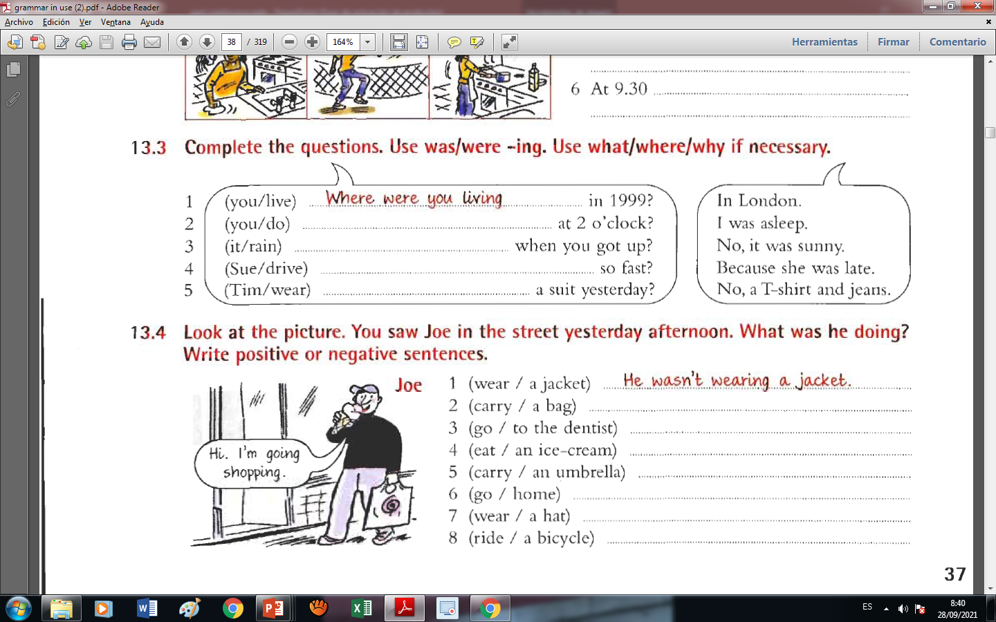

Slide 14
While- When
They’re known as clauses and do have a meaning, but are often not complete sentences or have an exact meaning without a sentence followed to close the idea.
Even though they have similar meanings, when you talk about things in the past, "when" is most often followed by the verb tense simple tense, whereas "while" is usually followed by past continuous.
"While" expresses the idea of "during that time.“
I was eating when she called
While I was studying, she called

Slide 15
While he ______________ (have) breakfast, the postman _____________ (knock) on the door.
was having
knocked

Slide 16
When we _____________ (get) home from school, mum _________________ (make) bread.
got
was making

Slide 17
He ______________ (slip) and fell while they __________________ (walk) home.
slipped
were walking

Slide 18
I ___________________ (not/want) to bother her because she _________________
(read) the newspaper.
didn’t want
was reading

Slide 19
While he ________________ (board) the plane, he accidentally _____________ (drop) his case.
was boarding
dropped

Slide 20
He _____________________ (cycle) downhill when the brakes ______________ (fail).
was cycling
failed

Slide 21
Julie ________________ (have) a shower when the telephone _____________ (ring).
was having
rang

Slide 22
John __________________ (fish) when he ______________ (see) a bear!
was fishing
saw

Slide 23
Daniel ________________ (mend) some shoes when the customer ____________ (come) into the shop.
was mending
came

Slide 24
They _________________ (jog) in the park when it _________________ (start) to rain.
were jogging
started

Slide 25
She __________________ (do) some exercises when she ______________ (feel) a pain in her chest.
was doing
felt

Slide 26
He _________________ (walk) the dog when he _______________ (hear) the shot.
was walking
heard

Slide 27
He _________________ (carry) the box when he _______________ (trip) and fell.
was carrying
tripped

Slide 28
She ________________ (have) a swing when the branch ______________ (break)
was having
broke

Slide 29
She ________________ (ski) when the avalanche ______________ (start).
was skiing
started

Slide 30
The children _____________________ (have) a pillow fight when their mother ______________ (come) in the room.
were having
came

Slide 31
They _________________ (play) chess when the children _____________ (come) home.
were playing
came

Slide 32
He _______________ (talk) on the phone when the boss _____________ (arrive).
was talking
arrived

Slide 33
Wendy _________________ (wear) a pink dress when they ______________ (arrive) at the party.
was wearing
arrived

